Slide 1
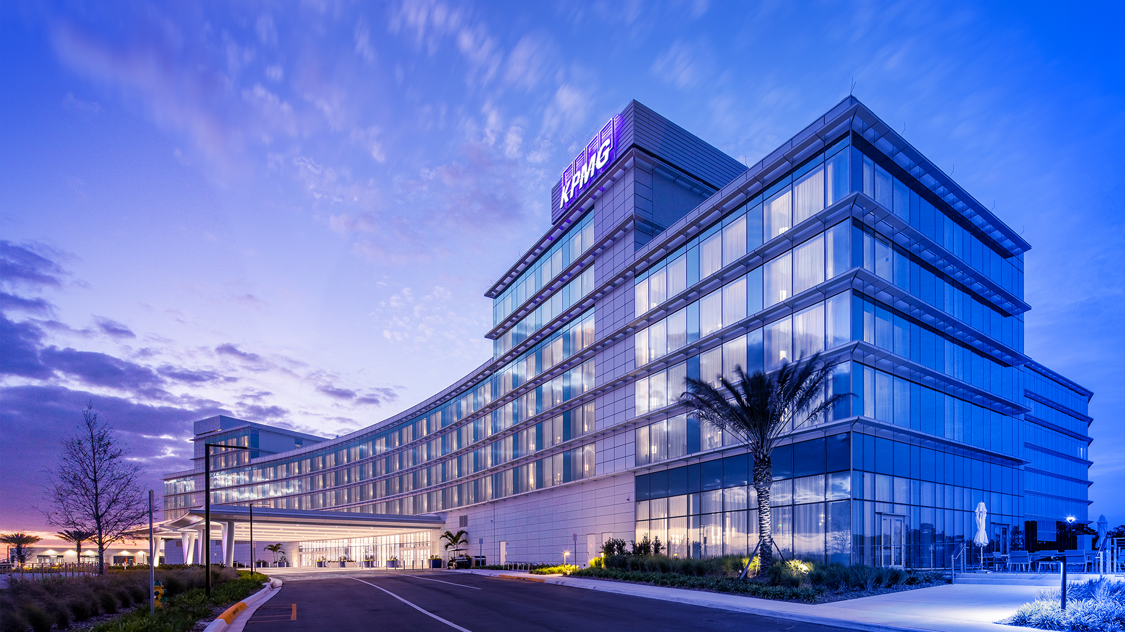

Disney
AI for Tax

Slide 2







AI Strategy for Disney
This set of core principles outlines how we’ve approached the roadmap and architecture for building and scaling GenAI solutions for Disney– prioritizing and balancing modularity, maintainability, cost, and accessibility for both technical and non- technical users.
Core Principles
Modular
Build AI systems with interchangeable components that are easier to scale, adapt, replace, and maintain over time.
Scalable
Configure AI solutions to grow seamlessly as data, users, and use cases expand — without major rework.
Available within Disney
Prioritize technology and platforms already vetted and supported internally to improve compliance and integration.
Modern stack / ability to swap models
Design solutions using flexible architectures that allow easy expansion, replacement, or upgrading of AI models, as needed.
Easy to maintain
Prioritize systems are simple to monitor, debug, and update —minimizing operational overhead and technical debt.
Reasonable cost of ownership
Balance performance and innovation with budget-conscious choices that deliver sustained value.
Citizen-developer friendly / Vibe coding ready
Empower non-technical users to build and customize AI tools using intuitive, low-code or no-code interfaces
Enables a flexible, scalable AI strategy that can evolve over time

Slide 3





















Current State Tax Technology Ecosystem
Key enterprise data source for priority use cases
Key tax data source for priority use cases
Apps
AI-powered apps (copilots, knowledge assistants) and existing Tax applications used by Disney Tax teams.
Applications
AI Apps
Tax Apps
Data Hub & Data Flow, Tax Provision, Common Entities
Checkpoint
DisneyGPT
Digital Gateway
Models
FMs, LLMs, other AI models incl tools & capabilities to tune and train models
Models
TAC (Machine learning algorithm within contributions database)
Enterprise IAM
Compute
Hardware and software resources train, tune, run, and serve models
Compute
Tax has the option to create their own cloud tenant in Azure – don’t have anything deployed in Azure today
Content / Data
Data sources and platforms frequently used by Disney Tax teams and needed to develop AI use cases.
Data Sources / Platforms
fshelp
ControlPoint
Concur
Olaf
EDP
GTP
OSA
Data Hub & Data Flow
Data Hub & Data Flow, Tax Provision, Common Entities
Olaf, Cognos, and OSA (getting an API later in 2025) are not currently accessible by API

Slide 4
Prioritization Matrix
We leveraged a prioritization framework that evaluates value GenAI use cases bring to the business against technical complexity – bucketing high value use cases into three buckets: quick wins, strategic plays, and advanced AI solutions.
High
Now - Quick Wins
Shorter term plays with high value potential
Next - Strategic Plays
Medium term plays with high value potential
Later: Advanced AI Solutions
Longer term plays with high value potential
Dimension |  | Definition
Complexity | Data Readiness | Is the data accessible? Is the data clean? Are there restrictions on the data?
 | Technical Readiness | How much development effort will this require?
 | Business Risk | What is the level of reputational, regulatory, or other external risk?
 | Quality of Output | How accurate do the results need to be?
Value | Business Impact | What benefits are realized by this use case?
 | Scalability | How scalable is the impact to the business?
10 Use Cases
17 Use Cases
17 Use Cases
Value
Resource Distractors
Attractive capabilities that produce minimal incremental value
Hold For Now
Capabilities that require a little further investment
6 Use Cases
17 Use Cases
For more details on specific use cases and prioritization scoring, click here
Low
Low
Complexity
High

Slide 5


Reference Architecture: Conceptual
DRAFT: FOR DISCUSSION
The conceptual reference architecture provides a high-level overview of the essential components and data flow required to enable GenAI use cases in tax, focusing on what needs to exist – such as data sources, processing layers, and user interfaces – without specifying how these elements are implemented.
Cloud Network
Data Sources
Systems of record containing structured and unstructured tax data.
Data Ingestion
Applications to connect and extract data from source systems.
AI/ ML Accelerators
LLM base models, build and train AI models.
Applications
UI/UX
Users interact with applications and model outputs.
Application Layer
Tax Data
Streaming
Models
MS 365 Copilot
API Management
Federation
Products
Enterprise Data
High-code Web Apps
User
Low-code Web Apps
3rd Party Data
Storage
Data Processing
Combine, clean, and transform data to be ready for consumption.
Structured Data
Disney GPT
Combine
Combine
Combine
Unstructured Data
Combine
Clean
Transform
Ready for consumption

Slide 6
Reference Architecture: Logical
DRAFT: FOR DISCUSSION
The logical reference architecture defines the structure and relationships between components – such as data sources, storage systems, AI accelerators, and application layers – detailing how data moves and is processed to support tax-specific applications.
Cloud Network
Data Sources
Systems of record containing structured and unstructured tax data.
Ingestion
Applications to connect and extract data from source systems.
AI/ ML Accelerators
LLM base models, build and train AI models.
Applications
UI/UX
Users interact with applications and model outputs.
Out of the box AI Apps
Tax Data
Tax Applications
Tax Users
Data Collection
LLMs
ML Models
Custom chat interfaces
Custom AI apps
Data Transformation
Functionally tuned agents
AI Agents
AI App Management
Enterprise Data
Data Loading
RAG
Copilot
User
3rd Party Data
Storage
Data Processing
Combine, clean, and transform data to be ready for consumption.
Data Warehouse
Data Lakehouse
Combine
Combine
Combine
Cloud Storage
Combine
Clean
Transform
Ready for consumption

Slide 7








Reference Architecture: Physical
DRAFT: FOR DISCUSSION
The physical reference architecture translates the logical design into a concrete implementation by specifying the actual systems, platforms, and tools used to implement the GenAI solution from data sources to user interface.
Data Sources
Systems of record containing structured and unstructured tax data.
Ingestion
Applications to connect and extract data from source systems.
AI/ ML Accelerators
LLM base models, build and train AI models.
Applications
Native AI/ “LoB” AI applications, custom AI apps
UI/UX
Users interact with applications and model outputs.
API
LLMs
Custom Apps
OneSource Platform
APIs
Potential Additional Data Sources*
API Management
Pre-built connectors
DisneyGPT
Custom connectors
Copilot Agent Builder
Native AI Apps
Azure AI Foundry
Digital Gateway
Initially, then migrate to Disney
Cortex AI
Genie
Copilot Studio
User
Storage
Data Processing
Combine, clean, and transform data to be ready for consumption.
Olaf
EDP
GTP
OSA
Combine
Combine
Combine
For Discussion
Combine
Clean
Transform
Ready for consumption
*Many of these additional data sources are available through data hub

Slide 8




KPMG & Disney AI for Tax Partnership
What are the key benefits?
The benefits of our AI Factory are not just theoretical; they are proven realities already delivering value within Disney's own environment.
Our partnership has already established the framework to scale these advantages across the enterprise with speed and confidence.
KPMG and Disney Tax’s Proven AI Factory Model
KPMG is not just an advisor; we are Disney's proven execution partner. We have moved beyond strategy and have successfully built and deployed a production-ready AI ecosystem within the Disney enterprise environment. We partnered to cut through the enterprise red tape, navigate the complexities of your internal systems, and deliver tangible AI solutions that are actively creating value today. Our partnership has already established the foundation for scaling AI responsibly and effectively across your organization.
What is the KPMG AI Factory for Disney?
The KPMG AI Factory is a repeatable, scalable model that accelerates the delivery of trusted, high-impact AI solutions. For Disney, this is not a future concept - it's a reality. We have built a functioning factory that leverages your existing investment in Microsoft Copilot and the Microsoft Power Platform, using a common set of proven components and build patterns. It is an engine designed to:
Discover new opportunities for AI to drive value.
Reuse established, compliant components to build solutions quickly.
Deploy AI agents and applications seamlessly into your business processes.
Accelerated Time-to-Value
Continuous Improvement and Reusability
Innovation value derived monetization
Cleared for Enterprise-Wide Adoption

Slide 9



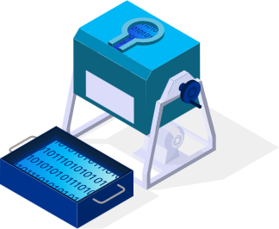


Enable AI Potential with Value and Speed
The pace of AI is both a threat and an opportunity. Our proven partnership unlocks real value for Disney by using an established library of AI building blocks.
The team has established five reusable patterns provide a repeatable foundation for creating high-impact solutions that increase efficiency, ensure compliance, and drive smarter business decisions.
Value
11 Agents
are already live in production, your teams are experiencing the benefits of our partnership today. These agents are actively increasing efficiency, providing faster access to critical information, and improving decision-making across the Tax organization.
Value
Prolonged AI initiatives with uncertain results are no longer sustainable.
We offer a solid foundation of pre-built, tested, and deployable AI components, allowing Disney to bypass the foundational work and concentrate on customizing solutions that address your unique business requirements.
This strategy is already proven at Disney, delivering measurable enhancements in operational efficiency and innovation in a fraction of the time.
Speed
Speed

Slide 10











KPMG & Disney AI for Tax Partnership Agents
Copilot Studio Agents (Production Ready February 2026)
Indirect & Direct Tax Notice Tracker
Indirect & Direct Tax Refund Tracker
Country by Country Variance Reporting
Commercial Domicile
Demo Today
Demo Today
Demo Today
Copilot Declarative Agents (Currently in User Testing at Disney)
PIP Internal Research Summary
SOX Transaction Research Assistant
FDII Contract Review
Disney Acronym Assistant
Power Query and Excel Support
Disney Tax Accounting Policy FAQ
External Reporting Lexicon Support

Slide 11
Proven Build Patterns in Disney Environment
01
02
03
04
05
AI Process Automation
Transforms high-volume manual processes into streamlined workflows using AI to digitize, understand, and route information.
Live in the Tax Environment:
For the Notice & Refund Tracker, the agent reads scanned PDFs, to send to a dashboard to automatically create and routes tasks in Workfront.
Live Data Enrichment
Automatically enhances internal datasets with real-time information gathered from targeted external web searches.
Live in the Tax Environment:
The Commercial Domicile agent performs live web searches to find an entity's legal headquarters and updates the team's Excel sheet directly.
Narrative Generation
Synthesizes information from multiple sources to automatically generate consistent, compliant text for recurring reporting.
Live in the Tax Environment:
The CbyC Variance Report Builder consolidates text from various documents to create regulatory-ready narratives, automating the manual drafting process.
AI Compliance Review
Provides an AI-powered first-pass review of documents to identify and flag non-compliant terms or specific clauses against external and internal policies.
Live in the Tax Environment:
Our FDII and SOX agents scan contracts and memos to accelerate expert review and ensure adherence to complex compliance rules.
Knowledge Engine
Creates a single, conversational source of truth that provides instant, accurate answers from a complex library of internal knowledge.
Live in the Tax Environment:
The PIP Research and Tax Knowledge agents allow users to ask questions and get immediate answers from internal policy and research documents.

Slide 12
Copilot Studio Agents (Production Ready February 2026)
01
Notice Tracker
End-to-end solution for the management for all incoming direct and indirect tax notices. The agent uses AI to read scanned documents, extract critical data, and create tasks in Workfront, creating a transparent process that minimizes costly interest payments.
02
Refund Tracker
End-to-end tracking and action process for all tax refunds. The agent digitizes refund checks and correspondence, extracts key data, and monitors status, ensuring that all refunds are collected in a timely manner & accelerating cash recovery for the company.
03
Country by Country Variance Reporting
Automates the creation of CbyC report narratives by consolidating text from multiple sources into a compliant format. This saves hours of manual drafting, ensures lexicon compliance, and frees senior analysts for high-value review.
04
Commercial Domicile
An agent integrated directly within Excel that executes the extensive research of determining an entity’s commercial domicile. It performs live web- search and updates the sheet, saving the department hours and enabling faster, more accurate tax planning..

Slide 13







Indirect Tax Notice Data Flow/Architecture
Power Automate Flow
Display Dataverse table in PowerApps dashboard for human review
Source | Dataverse Fields
Extracted from Scanned Notice | Description Primary Return ID Jurisdiction Notice Date Notice Tax Period Tax Type Reason of Notice Notice Type Master/Duplicate EFT or Check Tax Amount Interest Amount Penalty Amount Other Amount Total Due Refund Amount - SUT Flag
Gold Calendar | Name
Power Automate | UniqueIndirectNoticeRefundID Notice Number Power Automate Flow Status Workfront URL Task Status SharePoint URL SharePoint File Name Date File Uploaded to SharePoint Assigned To
Power Automate Flow
Content Understanding to extract Primary Return ID and other data points
New Scanned Notice or Refund
Power Automate Trigger
Create task in Indirect Notices Project
Search Gold Calendar for Primary Return ID; Return Name (ex. CO-06-LO-49)
Add row in Dataverse table with all data points

Slide 14

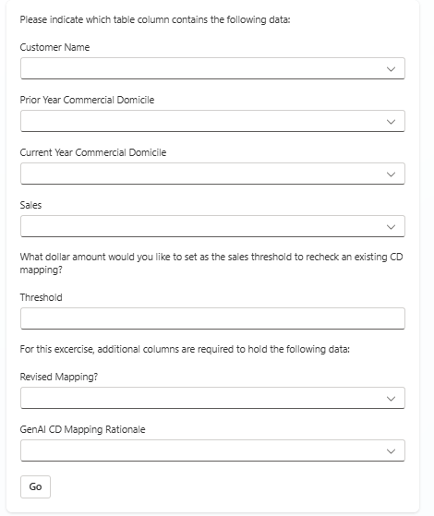

Commercial Domicile Data Flow/Architecture
Launch Copilot in Excel and select Agent
Power Automate Flow
Loop through rows and continue flow if one of the following conditions is met:
HQ State column is blank
HQ State column is not blank BUT Sales is above threshold
Bing search the commercial domicile of the customer and return the following:
State (two-letter abbreviation)
Rationale/direct quote from web search
Update Excel
User opens Commercial Domicile List in Excel
In side panel, user will be prompted to provide the above information (upload spreadsheet, indicate table name, columns, threshold)

Slide 15
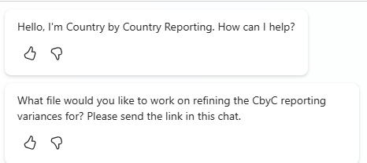

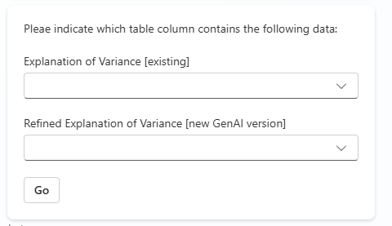
CbyC Variance Reporting Data Flow/Architecture Part 1
Launch Copilot in Excel and select Agent
Power Automate Flow
Loop through rows and continue flow if one of the following conditions is met:
ExplanationofVariances column has text
Run prompt to refine narrative and return the following:
1. RefinedExplanationofVariances
Update Excel column “RefinedExplanationofVariances” with refined narrative
User opens CbyC Narratives List in Excel
In the side panel, user will be prompted to provide the above information about the spreadsheet they have uploaded

Slide 16
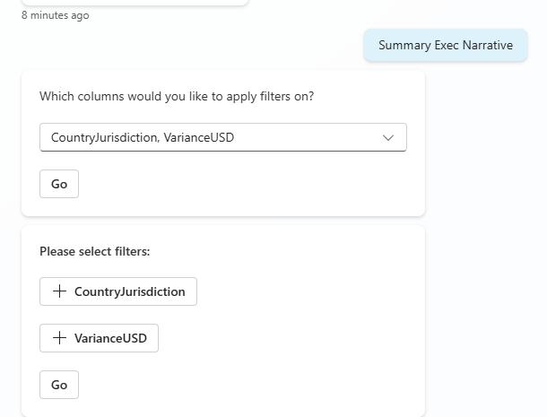
CbyC Variance Reporting Data Flow/Architecture Part 2
Power Automate Flow
Launch Copilot in Excel and select Agent
Filter rows by Jurisdiction and Category and loop through rows if one of the following conditions is met:
RefinedExplanationof Variances column has text
Run prompt to summarize narratives for the identified Jurisdiction and Category and return the following:
SummaryStatement ExplanationofVariances
Update Excel column “SummaryStatement ExplanationofVariances” with summarized narrative statement
User opens CbyC Narratives List in Excel
In the side panel, user will be prompted to provide the above information

Slide 17
Two paths translating use cases into realizable value
Productivity
Unlocks capacity for the Org
(i.e. do same with less time/salary or do more with same time/salary)
Capacity realized as savings ($)
OR
ROI
Copilot use case drives business value
Capacity reused ($)
OR
Value
Unlocks value outcome for the Org
(i.e. Change in output or result that drives revenue potential or cost avoidance (non-salary))
Non-Salary cost out ($)
OR
Other intangible benefit e.g. reputational/wellbeing
Quality
Compliance

Slide 18
Copilot Agent Value Realization
= Declarative Agent
= Studio Agent
1
3
4
8
9
10
11
1
Disney Acronym Assistant
Productivity
Capacity realized as savings ($)
ROI
Unlocks capacity for the Org
(i.e. do same with less time/salary or do more with same time/salary)
2
PIP Internal Research Agent
OR
3
Power Query and Excel Support
Copilot use case drives business value
Capacity reused ($)
4
SOX Transaction Research Assistant
OR
Value
5
Tax Accounting Policy FAQ
Unlocks value outcome for the Org
(i.e. Change in output or result that drives revenue potential or cost avoidance (non-salary))
Non-Salary cost out ($)
6
FDII Contract Review
OR
Other intangible benefit e.g. reputational/wellbeing
7
External Reporting Lexicon Support
8
Indirect & Direct Tax Notice Tracker
Quality
Compliance
2
5
6
7
9
Indirect & Direct Tax Refund Tracker
8
9
10
11
10
Country by Country Variance Reporting
11
Commercial Domicile

Slide 19
Direct and Indirect Tax Notice Tracker Agent - Time Saved
Before Copilot: It takes a team of 4 admins (2 per function) 30 minutes per notice to manually scan, save, enter data in Workfront, and triage each of the 1,000+ notices received annually.
After Copilot: The same process now takes <1 minute per notice as the agent executes the entire intake and data entry workflow.
Time Savings
Notices per year: 500 (Direct) + 500 (Indirect) = 1,000 notices
Time per notice (Before): 30 minutes
Time per notice (After): 1 minute
Time saved per notice: 30 - 1 = 29 minutes
Total minutes saved annually: 1,000 notices * 29 minutes/notice = 29,000 minutes
Total hours saved annually: 29,000 minutes / 60 = 483.3 hours
Total Hours Saved Annually: 483 Hours
Value Realized
Salary Cost Savings:
Hourly Rate for Admin: $75,000** salary / 2,080 annual work hours = $36.06/hour
Total Annual Salary Savings: 483.3 hours * $36.06/hour = $17,428
Interest Savings
An estimated $10,000 from reduced interest payments due to timely processing
Total Cost Savings Annually: $27,428
Disclaimer: The team conducted brief interviews with team members to gain an understanding on the timing requirements. Regular follow ups will be performed to ensure the accuracy of the calculations.
**$75,000 is an illustrative example of salary. This is not based on Disney compensation data.

Slide 20
Direct and Indirect Tax Refund Tracker Agent - Time Saved
Before Copilot: It takes a team of 4 admins (2 per function) 30 minutes per refund to manually scan, save, enter data in Workfront, and triage each of the 1,000+ refunds received annually.
After Copilot: The same process now takes <1 minute per notice as the agent does the entire intake and data entry workflow.
Time Savings
Refunds per year: 500 (Direct) + 500 (Indirect) = 1,000 refunds
Time per refund (Before): 30 minutes
Time per refund (After): 1 minute
Time saved per refund: 30 - 1 = 29 minutes
Total minutes saved annually: 1,000 refunds * 29 minutes/refunds = 29,000 minutes
Total hours saved annually: 29,000 minutes / 60 = 483.3 hours
Total Hours Saved Annually: 483 Hours
Value Realized
Salary Cost Savings:
Hourly Rate for Admin: $75,000** salary / 2,080 annual work hours = $36.06/hour
Total Annual Salary Savings: 483.3 hours * $36.06/hour = $17,428
Accelerated Cash Recovery
An estimated $10,000 value obtained from accelerated cash recovery
Total Cost Savings Annually: $27,428
Disclaimer: The team conducted brief interviews with team members to gain an understanding on the timing requirements. Regular follow ups will be performed to ensure the accuracy of the calculations.
**$75,000 is an illustrative example of salary. This is not based on Disney compensation data.

Slide 21
Commercial Domicile Agent - Time Saved
Before Copilot: It takes a manager and three of her team members 20 hours per week per cycle to conduct research as part of the commercial domicile exercise over the course of a month.
After Copilot: The same team takes 1 hour per week total to complete the commercial domicile exercise
Before Copilot: It takes a manager and three of her team members 20 hours per week per cycle to conduct research as part of the commercial domicile exercise over the course of a month.
After Copilot: The same team takes 1 hour per week total to complete the commercial domicile exercise
Annual Hours Analysis
Manual Hours (Before):
Manager: (20 hrs/wk x 4 wks/cycle x 2 cycles) = 160 Hours
Team: (3 people x 20 hrs/wk x 4 wks/cycle x 2 cycles) = 960 Hours
Total "Before" Hours = 1,120 Annual Hours
Agentic Hours (After):
Total "After" Hours = 8 Annual Hours (for setup & final review)
Total Hours Saved Annually: 1,112 Hours
Value Realized
Manual Cost (Before):
Hourly Rate for Manager: $150,000** salary / 2,080 annual work hours = $72.12/hour
Manager: 160 hrs x $72.12/hr** = $11,539
Hourly Rate for Team Member: $100,000* salary / 2,080 annual work hours = $48.08/hour
Team: 960 hrs x $48.08/hr* = $46,157
Total "Before" Cost = $57,696
Agentic Cost (After):
$432 (blended rate) x 8 hours = $3,456
Total Annual Salary Savings = $54,240
Disclaimer: The team conducted brief interviews with team members to gain an understanding on the timing requirements. Regular follow ups will be performed to ensure the accuracy of the calculations.
**$150,000 & *$100,000 are an illustrative examples of salary. This is not based on Disney compensation data.

Slide 22
Country by Country Variance Analysis Agent - Time Saved
Before Copilot: It takes a team of Senior Analysts 3 minutes per line item to manually find, copy, and consolidate narrative text for over 1,000 line items in a recurring, quarterly regulatory report.
After Copilot: The same process now takes less than 1 hour total per report, as the agent fully automates the narrative consolidation, leaving only a final validation for the analyst.
Annual Hours Analysis
Manual Hours (Before)
(1,000 line items/qtr x 3 min/item x 4 qtrs) / 60 min/hr
Total "Before" Hours = 200 Annual Hours
Agentic Hours (After)
(1 hour/qtr for review x 4 qtrs)
Total "After" Hours = 4 Annual Hours
Total Hours Saved Annually: 196 Hours
Value Realized
Manual Cost (Before)
Hourly Rate for Senior Financial Analyst: $120,000** salary / 2,080 annual work hours = $57.69/hour
200 hrs x $57.69/hr = $11,538
Total "Before" Cost = $11,538
Agentic Cost (After)
4 hrs x $57.69/hr = $231
Total "After" Cost = ~$231
Total Annual Salary Savings = $11,307
Disclaimer: The team conducted brief interviews with team members to gain an understanding on the timing requirements. Regular follow ups will be performed to ensure the accuracy of the calculations.
**$120,000 is an illustrative example of salary. This is not based on Disney compensation data.

